Slide 1
Unit-1: An Introduction to CN
Dr. Ashutosh Singh
www.ashutoshksingh.in

Slide 2
1-1 DATA COMMUNICATIONS
Data communications are the exchange of data between two devices via some form of transmission medium such as a wire cable.

Slide 3
1.1.1 Components
A data communications system has five components (see Figure 1.1).

Slide 4
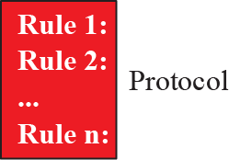
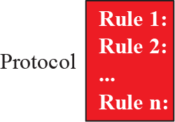
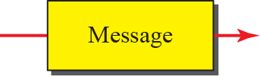


Figure 1.1: Five components of data communication

Slide 5
1.1.2 Data Representation
Information today comes in different forms such as text, numbers, images, audio, and video.

Slide 6
1.1.3 Data Flow
Communication between two devices can be simplex, half-duplex, or full-duplex as shown in Figure 1.2.

Slide 7
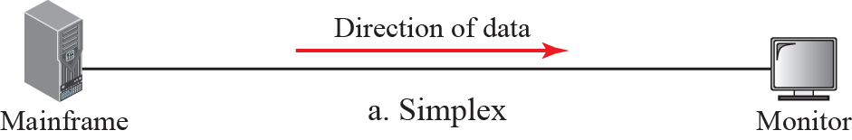
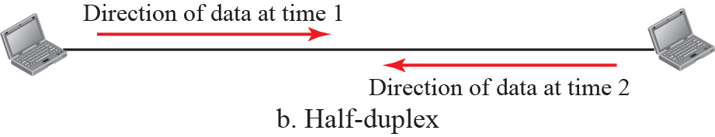
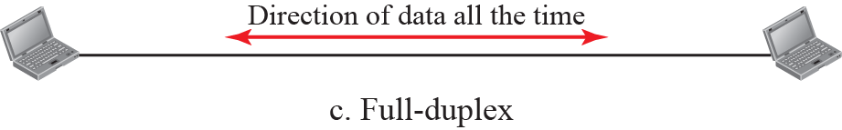
Figure 1.2: Data flow

Slide 8
1-2 NETWORKS
A network is a set of devices (often referred to as nodes) connected by communication links.
A node can be a computer, printer, or any other device capable of sending and/or receiving data generated by other nodes on the network.
A link can be a cable, air, optical fiber, or any medium which can transport a signal carrying information.

Slide 9
1.2.1 Network Criteria
A network must be able to meet a certain number of criteria. The most important of these are performance, reliability, and security.

Slide 10
1.2.2 Physical Structures
Before discussing networks, we need to define some network attributes.

Slide 11
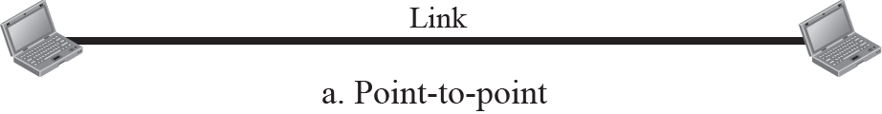
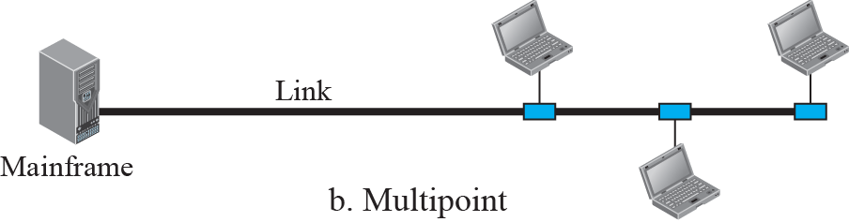
Figure 1.3: Types of connection

Slide 12
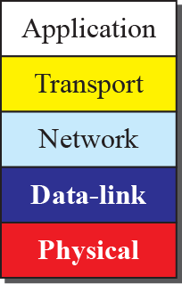
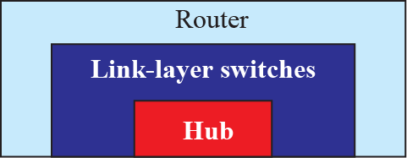
Figure 17.1: Three categories of connecting devices

Slide 13
17.17.1 Hubs
A hub is a device that operates only in the physical layer. Signals that carry information within a network can travel a fixed distance before attenuation endangers the integrity of the data. A repeater receives a signal and, before it becomes too weak or corrupted, regenerates and retimes the original bit pattern.

Slide 14
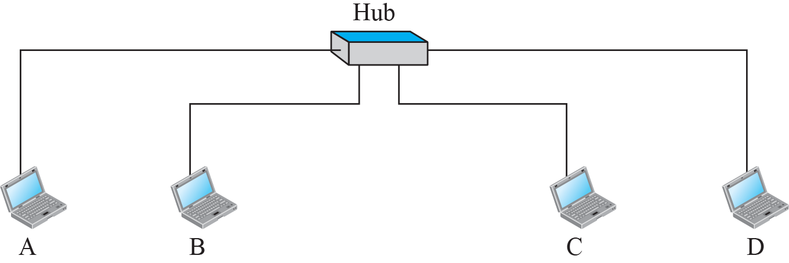



Figure 17.2: Hub

Slide 15
17.17.2 Link-Layer Switches
A link-layer switch (or switch) operates in both the physical and the data-link layers. As a physical-layer device, it regenerates the signal it receives. As a link-layer device, the link-layer switch can check the MAC addresses (source and destination) contained
in the frame.

Slide 16
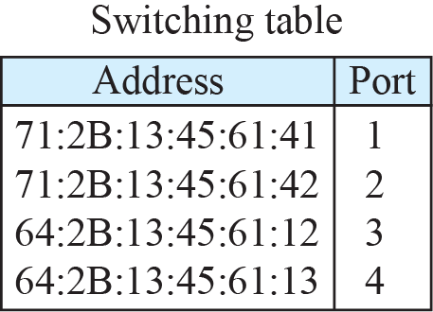
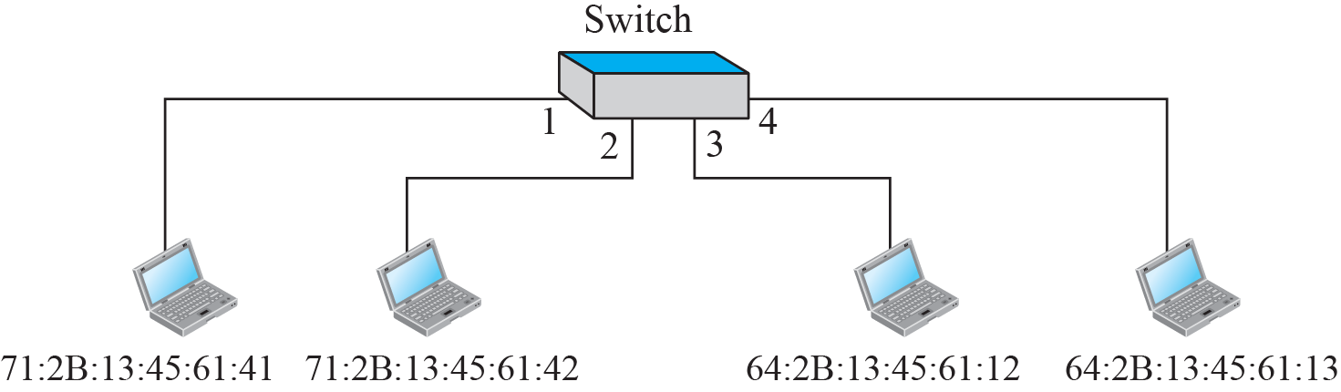
Figure 17.3: Link-Layer Switch

Slide 17
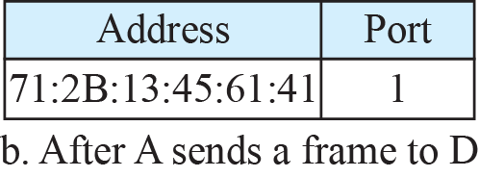
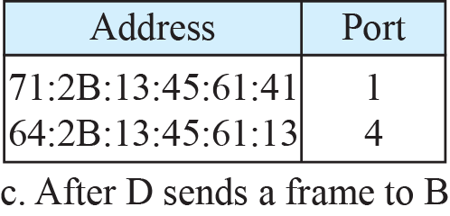
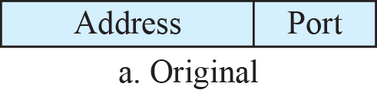
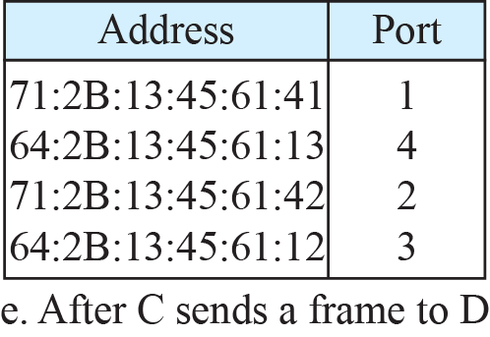
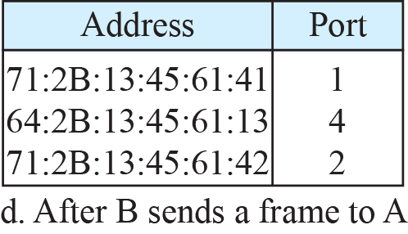

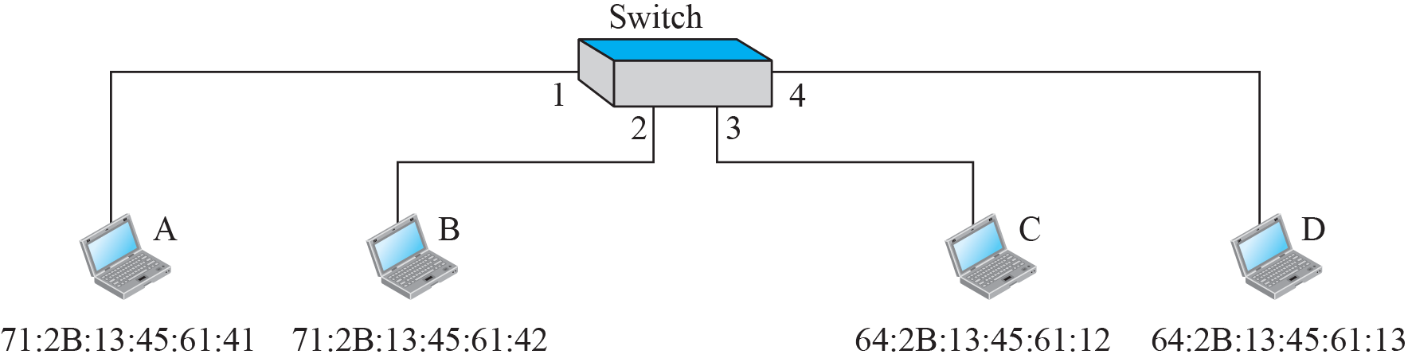
Figure 17.4: Learning switch

Slide 18
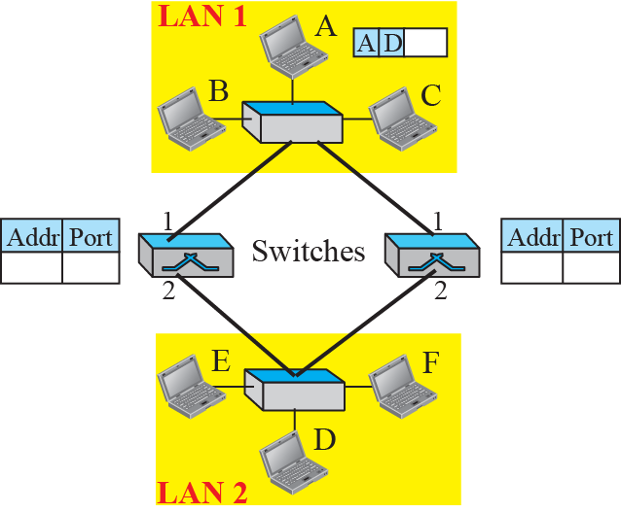
Figure 17.5: Loop problem in a learning switch (Part a)

Slide 19
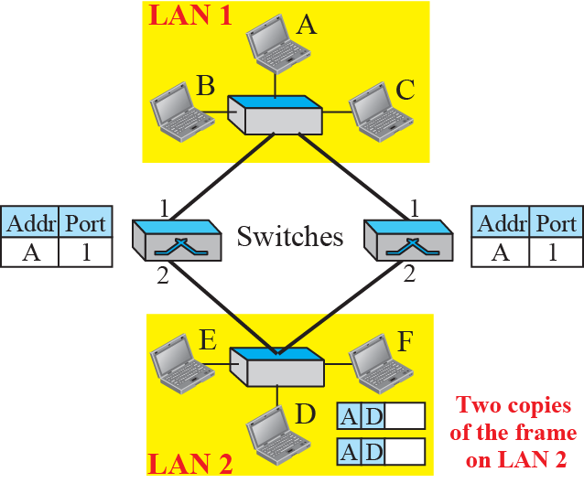
Figure 17.5: Loop problem in a learning switch (Part b)

Slide 20
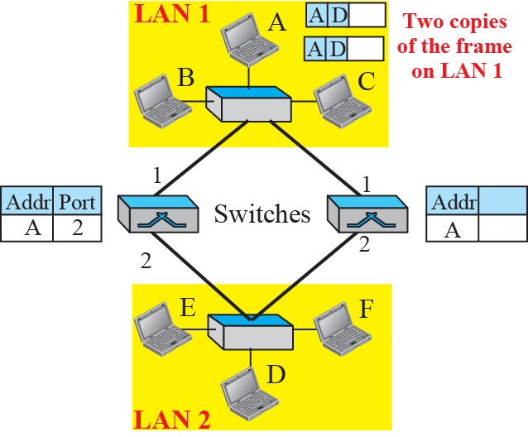
Figure 17.5: Loop problem in a learning switch (Part c)

Slide 21
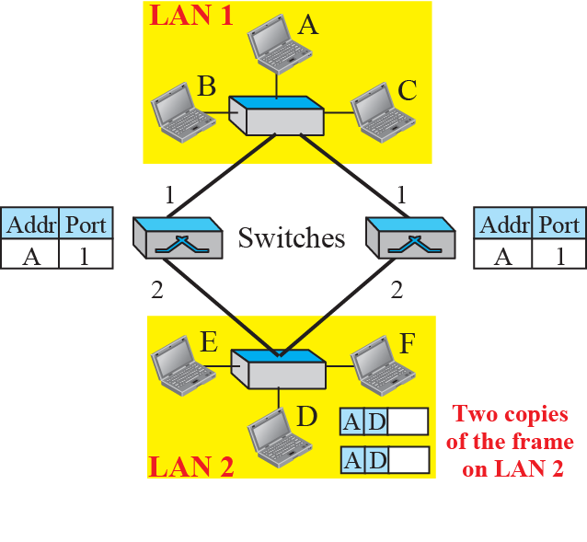
Figure 17.5: Loop problem in a learning switch (part d)

Slide 22
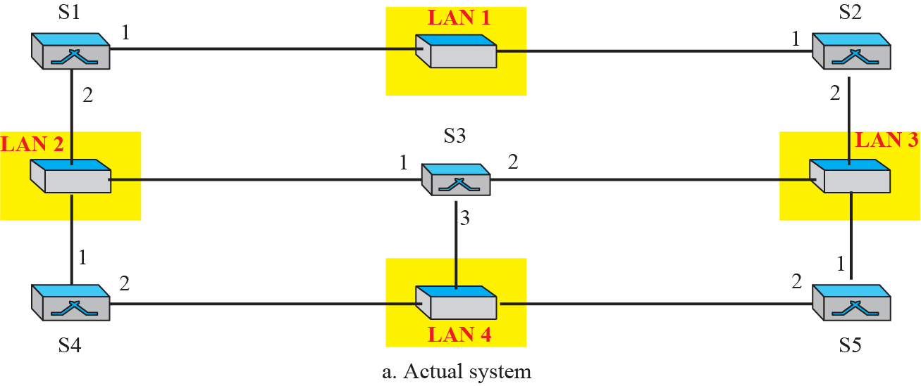
Figure 17.6: A system of connected LANs and its graph (Part a)

Slide 23
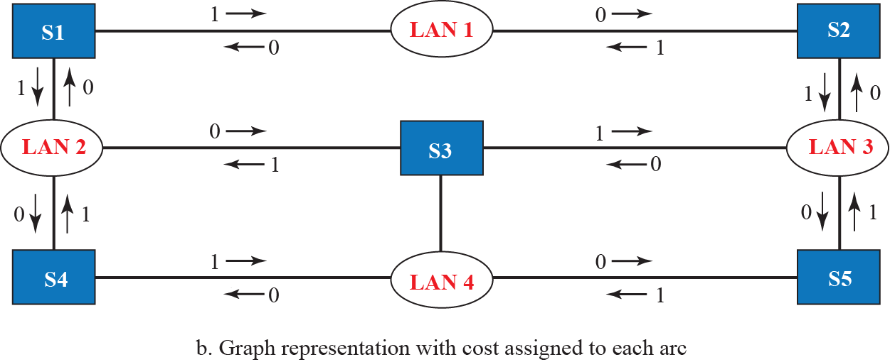
Figure 17.6: A system of connected LANs and its graph (Part b)

Slide 24
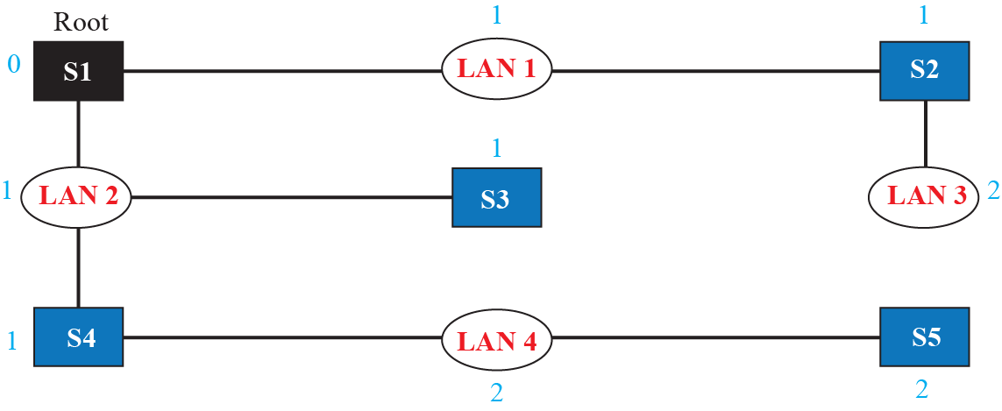
Figure 17.7: Finding the shortest path and the spanning tree for a switch.

Slide 25
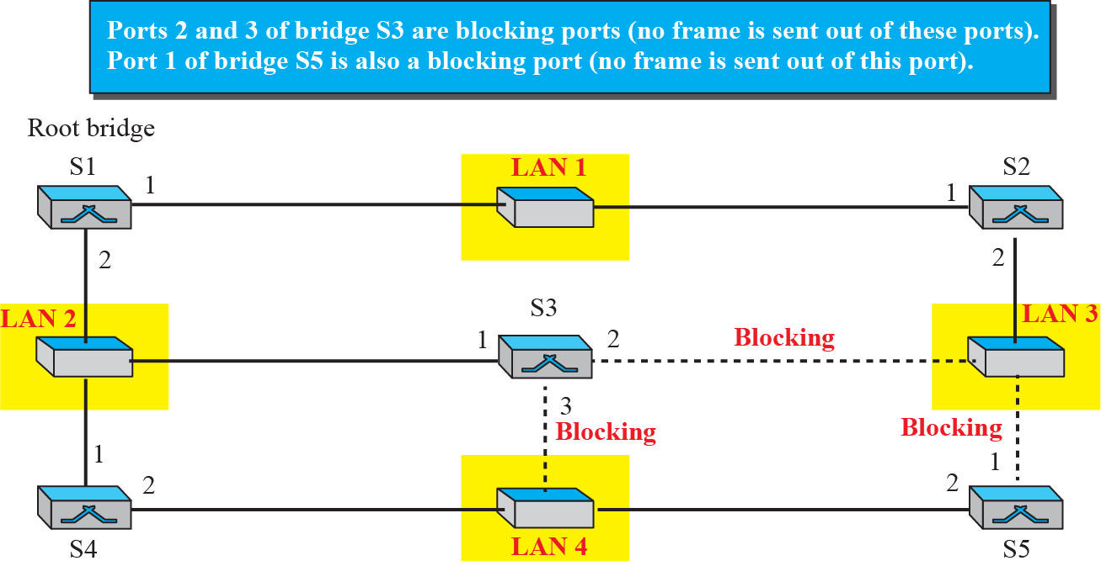
Figure 17.8: Forwarding and blocking ports after using spanning tree algorithm

Slide 26
17.17.3 Routers
We will discuss routers in Part IV of the book when we discuss the network layer. In this section, we mention routers to compare them with a two-layer switch and a hub. A router is a three-layer device; it operates in the physical, data-link, and network layers.

Slide 27
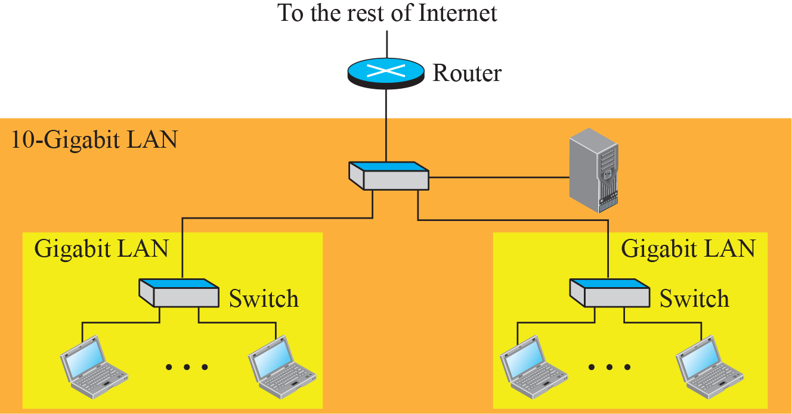
Figure 17.9: Routing example

Slide 28
17-2 VIRTUAL LANS
A station is considered part of a LAN if it physically belongs to that LAN. The criterion of membership is geographic. What happens if we need a virtual connection between two stations belonging to two different physical LANs? We can roughly define a virtual local area network (VLAN) as a local area network configured by software, not by physical wiring.

Slide 29
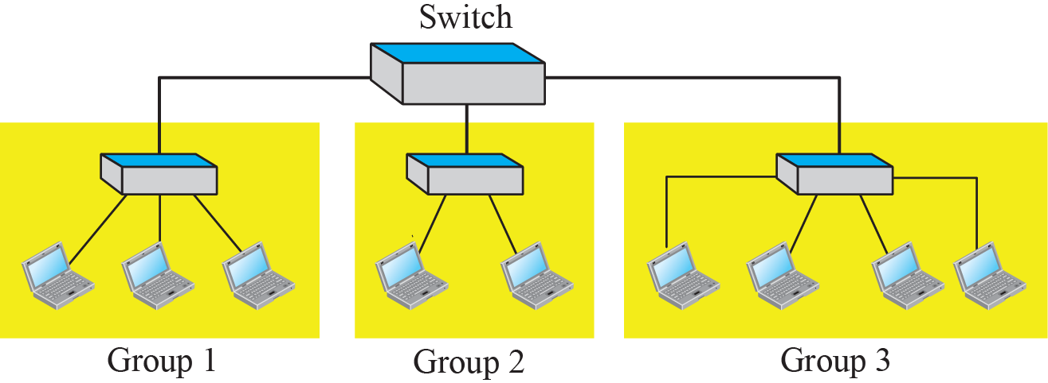
Figure 17.10: A switch connecting three LANs

Slide 30
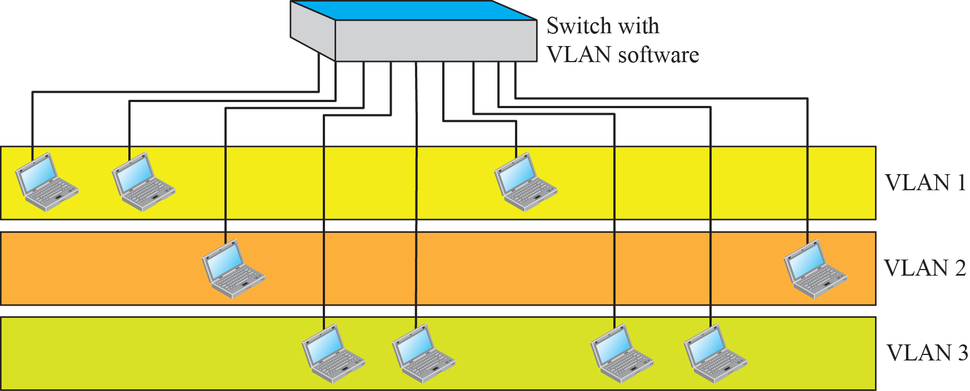
Figure 17.11: A switch using VLAN software

Slide 31
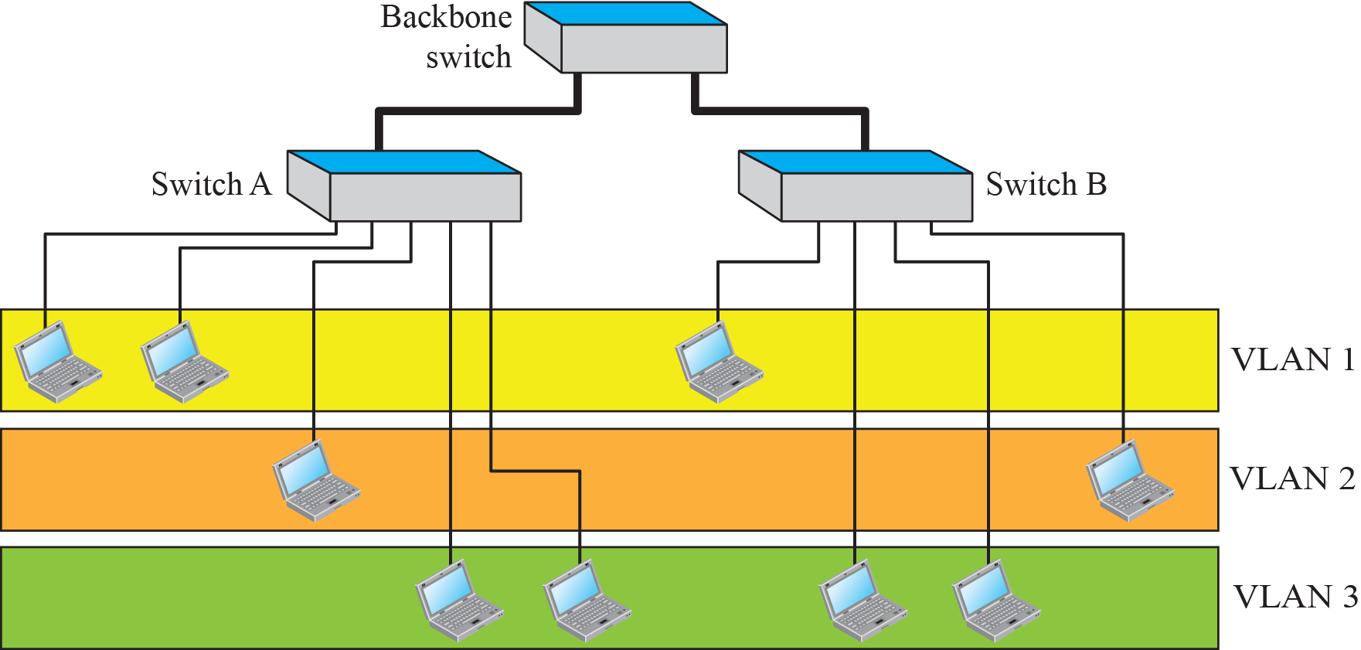
Figure 17.12: Two switches in a backbone using VLAN software

Slide 32
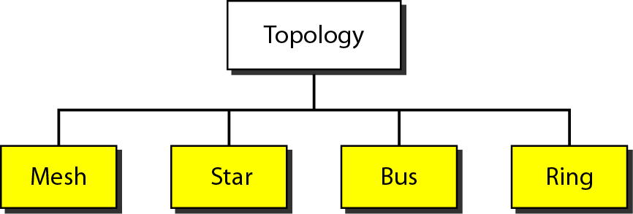
Figure 1.4 Categories of topology

Slide 33
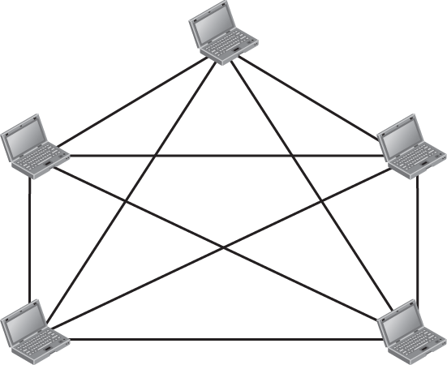


Figure 1.4: A fully-connected mesh topology

Slide 34
Mesh Topology
Total number of links = n (n-1)/2
Point-to-Point
Advantages
Reliability
Easily to identify fault .
Eliminating the traffic problems.
Security
Disadvantages
Installation and reconnection are difficult
More cables require.

Slide 35
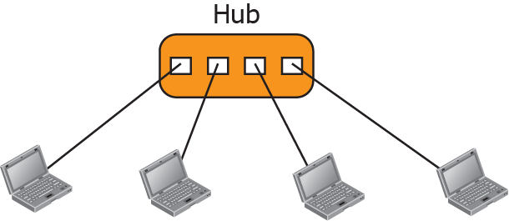
Figure 1.5: A star topology

Slide 36
Star topology
Total number of links = n
Point-to-Point
Advantages
Robust
Easier to configure
Addition ,shifting and deletion of nodes involve only one link.
Disadvantages
Star topology is dependent on Hub.

Slide 37
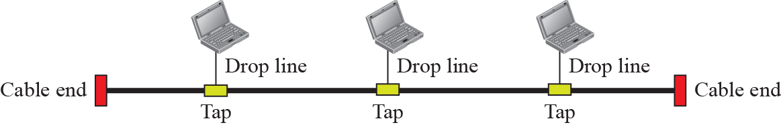
Figure 1.6: A bus topology

Slide 38
Bus Topology
Total number of links = n + 1
Multi-point connection
Advantages
Ease of installation.
Uses less cabling.
Addition ,shifting and deletion of nodes involve only one link.
Disadvantages
A fault in the backbone halts all the transmission.
Number of taps are limited

Slide 39
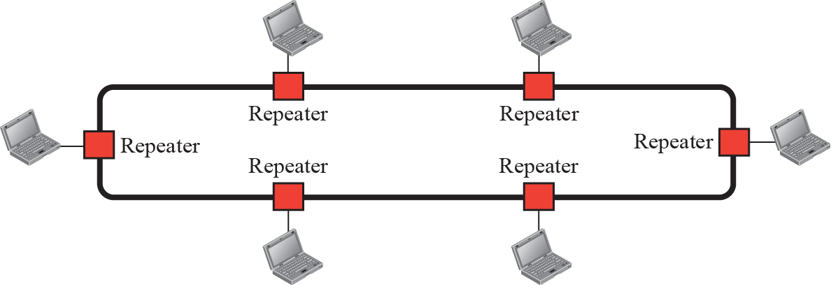
Figure 1.7: A ring topology

Slide 40
Categories of Networks
Local Area Networks (LANs)
Short distances
Designed to provide local interconnectivity
Wide Area Networks (WANs)
Long distances
Provide connectivity over large areas
Metropolitan Area Networks (MANs)
Provide connectivity over areas such as a city, a campus

Slide 41
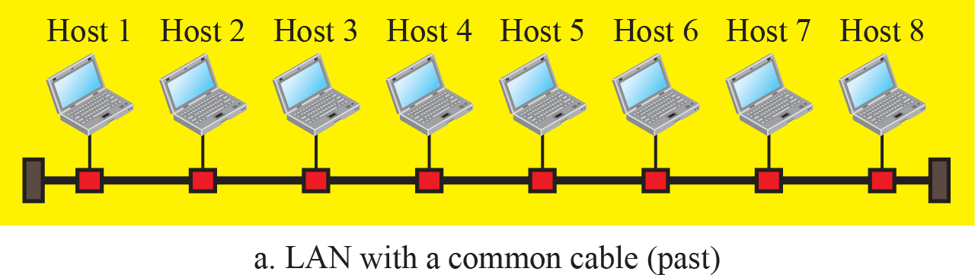
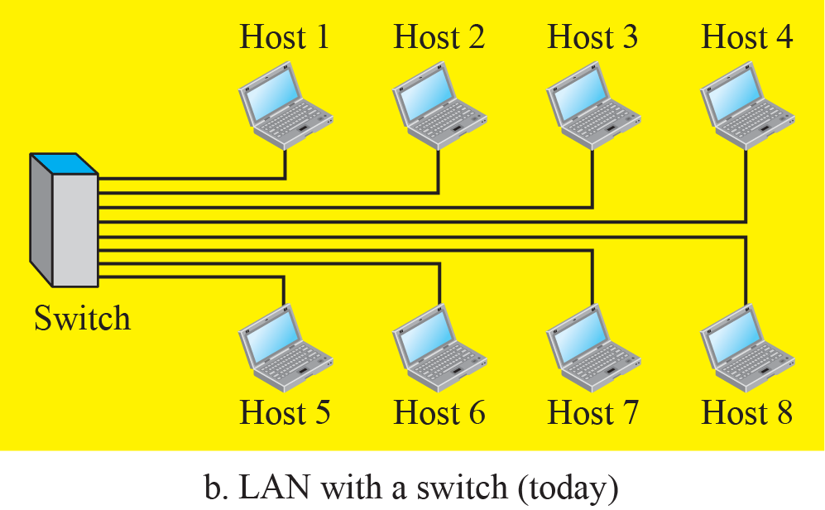
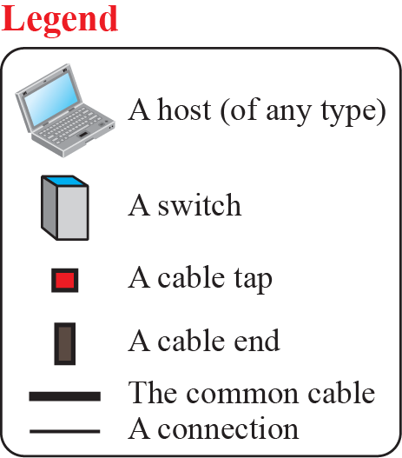
Figure 1.8: An Isolated LAN in the past and today

Slide 42
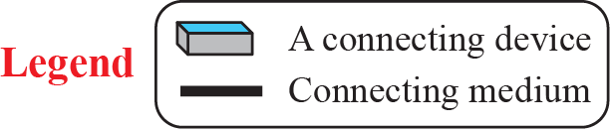
Figure 1.9: A Point-to-Point WAN

Slide 43
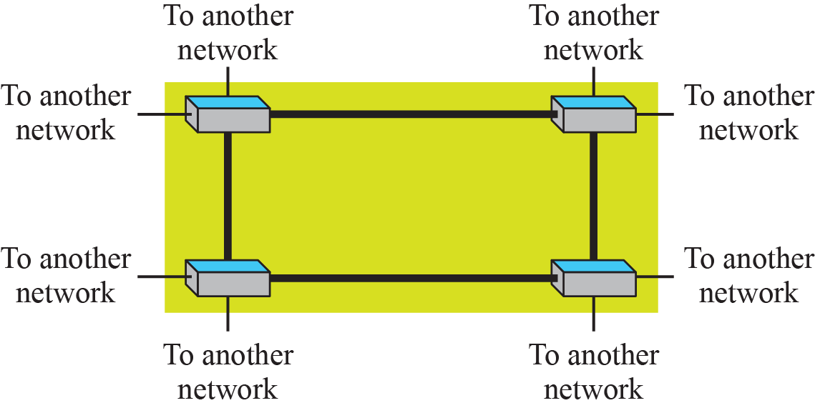
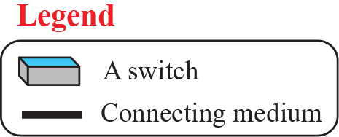
Figure 1.10: A Switched WAN

Slide 44
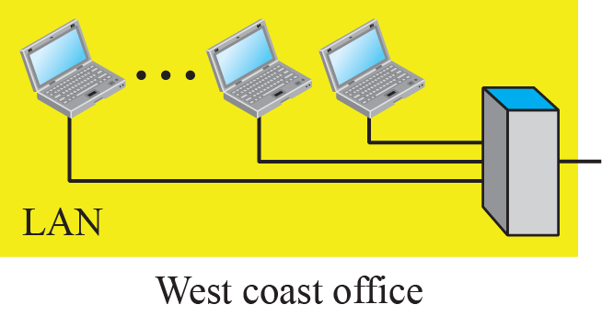
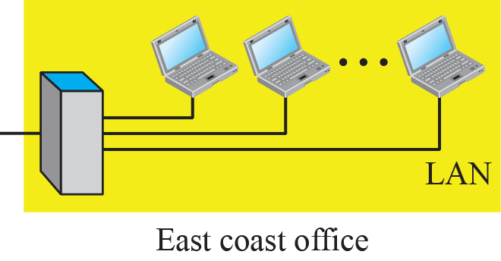
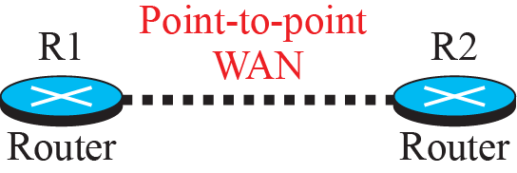
Figure 1.11: An internetwork made of two LANs and one WAN

Slide 45

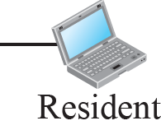
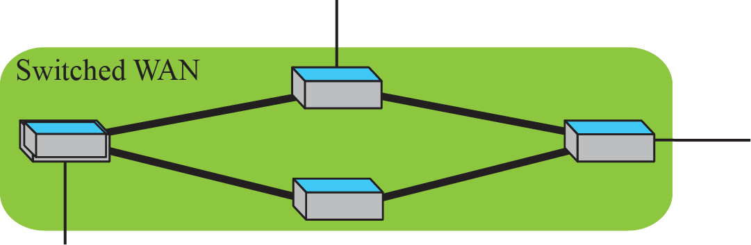
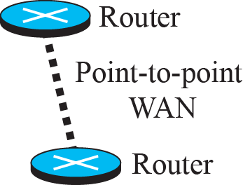
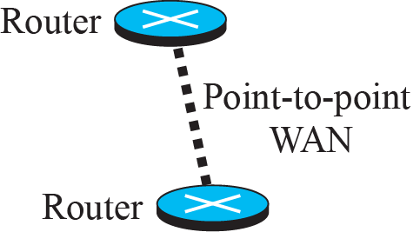
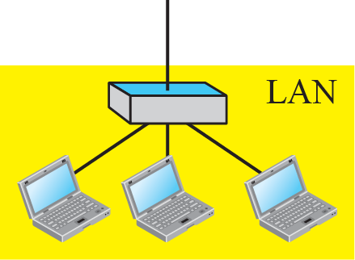

Figure 1.12: A heterogeneous network made of WANs and LANs

Slide 46
1.3.3 Switching
An internet is a switched network in which a switch connects at least two links together. A switch needs to forward data from a network to another network when required. The two most common types of switched networks are circuit-switched and packet-switched networks. We discuss both next.

Slide 47



Figure 1.13: A circuit-switched network

Slide 48



Figure 1.14: A packet-switched network

Slide 49
1.3.4 The Internet
An internet (note the lowercase i) is two or more networks that can communicate with each other.
The most notable internet is called the Internet (uppercase I ), and is composed of thousands of interconnected networks.
Figure 1.15 shows a conceptual (not geographical) view of the Internet.

Slide 50



Figure 1.15: The Internet today

Slide 51
1-4 INTERNET HISTORY
Now that we have given an overview of the Internet and its protocol, let us give a brief history of the Internet. This brief history makes it clear how the Internet has evolved from a private network to a global one in less than forty years.

Slide 52
1.4.1 Early History
There were some communication networks, such as telegraph and telephone networks, before 1960.
These networks were suitable for constant-rate communication at same time.
On the other hand, data received at variable rates at different times. The world needed to wait for the packet-switched network to be invented.

Slide 53
1.4.2 Birth of the Internet
In 1972, Vint Cerf and Bob Kahn, both of whom were part of the core ARPANET group, collaborated on what they called the Interneting Project.
They wanted to link dissimilar networks so that a host on one network could communicate with a host on another.
There were many problems to overcome: diverse packet sizes, diverse interfaces, and diverse transmission rates, as well as differing reliability requirements.
Cerf and Kahn devised the idea of a device called a gateway to serve as the intermediary hardware to transfer data from one network to another.

Slide 54
1-4 PROTOCOLS
A protocol is synonymous with rule. It consists of a set of rules that govern data communications. It determines what is communicated, how it is communicated and when it is communicated. The key elements of a protocol are syntax, semantics and timing
Topics discussed in this section:
Syntax
Semantics
Timing

Slide 55
Elements of a Protocol
Syntax
Structure or format of the data
Indicates how to read the bits
Semantics
Interprets the meaning of the bits
Knows which fields define what action
Timing
When data should be sent and what
Speed at which data should be sent or speed at which it is being received.

Slide 56

Why OSI Layered Model?

Slide 57

Tasks involved in sending a letter

Slide 58
OSI Reference Model
OSI stands for Open Systems Interconnection.
In the year 1984, It has been developed by ISO (International Standards Organization).
It is a 7 layer architecture with each layer having specific functionality to perform.
It is a reference model or we can say teaching model.
It is not practically implemented.

Slide 59

OSI Reference Model

Slide 60

OSI Reference Model (An Example)
Source: www.google.com

Slide 61
Placement Related Questions
Quest: Give the name of all 7 layers of OSI?
Ans: As discussed in previous slide.
Quest: What is difference between ISO and OSI?
Ans: ISO is the organization and OSI is the model.
Quest: What do you mean by term “open”?
Ans: It is ability to connect any two systems which conform to the reference model and associated standard.

Slide 62

An exchange using the OSI model
Source: Data Communication and Networking Book

Slide 63

Physical Layer
The physical layer is responsible for movements of individual bits from one node to other.
Source: Data Communication and Networking Book

Slide 64
Responsibilities of Physical Layer
Representation of bits
Transmission rate
Transmission mode
Synchronization of bits
Physical topology
Physical characteristics

Slide 65
Placement Related Questions
Quest: Give the names of physical layer devices
Ans: Hubs, Repeaters, Cables, etc.
Quest: What is the responsibility of Physical Layer in OSI Model?
Ans: Physical layer is responsible for sending bits (0 or 1) from source to destination.

Slide 66

Data Link Layer
The data link layer is responsible for moving frames from one node to other.
Source: Data Communication and Networking Book

Slide 67
Responsibilities of Data Link Layer
Framing
Flow control
Error control
Access control
Physical addressing

Slide 68
Placement Related Questions
Quest: Give the names of data link layer devices
Ans: Layer 2 Switch, Bridge, Modems, Network Card etc.
Quest: MAC Address work on which layer?
Ans: Data Link Layer

Slide 69

Network Layer
The network layer is responsible for the delivery of individual packets from the source host to the destination host.
Source: Data Communication and Networking Book

Slide 70
Responsibilities of Network Layer
Routing
Logical addressing

Slide 71
Placement Related Questions
Quest: Give the names of network layer devices
Ans: Layer 3 Switch, Router, etc.
Quest: What is Logical address?
Ans: Logical address is a IP address which are of two types i.e. IPv4 and IPv6.

Slide 72

Transport Layer
The transport layer is responsible for the delivery of a message from one process to another.
Source: Data Communication and Networking Book

Slide 73
Responsibilities of Transport Layer
Flow control
Error control
Segmentation and reassembly

Slide 74
Placement Related Questions
Quest: What is port number?
Ans: A port number is a way to identify a specific process.
Quest: What are the protocols used in Transport layer.
Ans: TCP and UDP

Slide 75
Session, Presentation, and Application layers
The session layer is responsible for dialog control and synchronization.
The presentation layer is responsible for translation, compression, and encryption.
The application layer is responsible for providing services to the user.

Slide 76

Summary of OSI Model
Source: Data Communication and Networking Book

Slide 77

TCP/IP Model

Slide 78


Figure 2.5: Addressing in the TCP/IP protocol suite

Slide 79


Figure 2.6: Logical connections between layers in TCP/IP
Logical connections

Slide 80

Figure 2.7: Identical objects in the TCP/IP protocol suite
Identical objects (messages)
Identical objects (segment or user datagram)
Identical objects (datagram)
Identical objects (datagram)
Identical objects (frame)
Identical objects (frame)
Identical objects (bits)
Identical objects (bits)

Slide 81

Comparison between OSI and TCP/IP

Slide 82
Placement Related Questions
Quest: Which model is better either OSI or TCP/IP
Quest: What is logical address?
Quest: How many layers are there in TCP/IP model?

Slide 83
3-1 DATA AND SIGNALS
Figure 3.1 shows a scenario in which a scientist working in a research company, Sky Research, needs to order a book related to her research from an online bookseller, Scientific Books.

Slide 84

Figure 3.1: Communication at the physical layer

Slide 85
3.1.1 Analog and Digital Data
Data can be analog or digital.
Analog data refers to information that is continuous;
Digital data refers to information that has discrete states.
For example, an analog clock that has hour, minute, and second hands gives information in a continuous form; the movements of the hands are continuous.
On the other hand, a digital clock that reports the hours and the minutes will change suddenly from 8:05 to 8:06.

Slide 86
3.1.2 Analog and Digital Signals
Like the data they represent, signals can be either analog or digital.
An analog signal has infinitely many levels of intensity over a period of time. As the wave moves from value A to value B, it passes through and includes an infinite number of values along its path.
A digital signal can have only a limited number of defined values. Although each value can be any number, it is often as simple as 1 and 0.

Slide 87


Figure 3.2: Comparison of analog and digital signals

Slide 88
3.1.3 Periodic and Nonperiodic
A periodic signal completes a pattern within a measurable time frame, called a period, and repeats that pattern over subsequent identical periods. The completion of one full pattern is called a cycle. A nonperiodic signal changes without exhibiting a pattern or cycle that repeats over time. Both analog and digital signals.

Slide 89
3-2 PERIODIC ANALOG SIGNALS
Periodic analog signals can be classified as simple or composite. A simple periodic analog signal, a sine wave, cannot be decomposed into simpler signals. A composite periodic analog signal is composed of multiple sine waves.

Slide 90
3.2.1 Sine Wave
The sine wave is the most fundamental form of a periodic analog signal.
Figure 3.3 shows a sine wave. Each cycle consists of a single arc above the time axis followed by a single arc below it.

Slide 91

Figure 3.3: A sine wave

Slide 92

Figure 3.4: Two signals with two different amplitudes

Slide 93
Example 3.1
The power in your house can be represented by a sine wave with a peak amplitude of 155 to 170 V. However, it is common knowledge that the voltage of the power in U.S. homes is 110 to 120 V. This discrepancy is due to the fact that these are root mean square (rms) values. The signal is squared and then the average amplitude is calculated. The peak value is equal to 21/2 × rms value.

Slide 94
Example 3.2
The voltage of a battery is a constant; this constant value can be considered a sine wave, as we will see later. For example, the peak value of an AA battery is normally 1.5 V.

Slide 95

Table 3.1: Units of period and frequency

Slide 96
Example 3.4
Express a period of 100 ms in microseconds.
Solution

Slide 97

Example 3.3
The power we use at home has a frequency of 60 Hz (50 Hz in Europe). The period of this sine wave can be determined as follows:
This means that the period of the power for our lights at home is 0.0116 s, or 16.6 ms. Our eyes are not sensitive enough to distinguish these rapid changes in amplitude.

Slide 98

Example 3.5
The period of a signal is 100 ms. What is its frequency in kilohertz?.
Solution
First we change 100 ms to seconds, and then we calculate the frequency from the period (1 Hz = 10^{–3} kHz).

Slide 99

Example 3.6
A sine wave is offset 1/6 cycle with respect to time 0. What is its phase in degrees and radians?
Solution
We know that 1 complete cycle is 360°. Therefore, 1/6 cycle is

Slide 100
Figure 3.11: Decomposition of a composite periodic signal

Slide 101
3.2.6 Bandwidth
The range of frequencies contained in a composite signal is its bandwidth. The bandwidth is normally a difference between two numbers. For example, if a composite signal contains frequencies between 1000 and 5000, its bandwidth is 5000 − 1000, or 4000.

Slide 102


Figure 3.13: The bandwidth of periodic and nonperiodic composite
signals

Slide 103

Example 3.10
If a periodic signal is decomposed into five sine waves with frequencies of 100, 300, 500, 700, and 900 Hz, what is its bandwidth? Draw the spectrum, assuming all components have a maximum amplitude of 10 V.
Solution
Let f_{h} be the highest frequency, f_{l} the lowest frequency, and B the bandwidth. Then

Slide 104


Figure 3.14: The bandwidth for example 3.10

Slide 105

Figure 3.16: The bandwidth for example 3.12

Slide 106
3-3 DIGITAL SIGNALS
For example, a 1 can be encoded as a positive voltage and a 0 as zero voltage.
A digital signal can have more than two levels.
In this case, we can send more than 1 bit for each level.
Figure 3.17 shows two signals, one with two levels and the other with four.

Slide 107


Figure 3.17: Two digital signals: one with two signal levels and the
other with four signal levels

Slide 108

Example 3.16
A digital signal has eight levels. How many bits are needed per level? We calculate the number of bits from the following formula. Each signal level is represented by 3 bits.

Slide 109
3.3.1 Bit Rate
Most digital signals are non-periodic, and thus period and frequency are not appropriate characteristics.
Another term—bit rate (instead of frequency)—is used to describe digital signals.
The bit rate is the number of bits sent in 1s, expressed in bits per second (bps).
Figure 3.17 shows the bit rate for two signals.

Slide 110

Example 3.18
Assume we need to download text documents at the rate of 100 pages per second. What is the required bit rate of the channel?
Solution

Slide 111
Example 3.20
What is the bit rate for high-definition TV (HDTV)?
Solution
HDTV uses digital signals to broadcast high quality video signals. The HDTV screen is normally a ratio of 16 : 9 (in contrast to 4 : 3 for regular TV), which means the screen is wider. There are 1920 by 1080 pixels per screen, and the screen is renewed 30 times per second. Twenty-four bits represents one color pixel. We can calculate the bit rate as
The TV stations reduce this rate to 20 to 40 Mbps through compression.

Slide 112

3.3.2 Bit Length
We discussed the concept of the wavelength for an analog signal: the distance one cycle occupies on the transmission medium. We can define something similar for a digital signal: the bit length. The bit length is the distance one bit occupies on the transmission medium.

Slide 113
3.3.4 Transmission of Digital Signals
A digital signal is a composite analog signal. The bandwidth is infinite, as you may have guessed. We can intuitively come up with this concept when we consider a digital signal.
A digital signal, in the time domain, comprises connected vertical and horizontal line segments.
A vertical line in the time domain means a frequency of infinity: a horizontal line in the time domain means a frequency of zero.
Going from a frequency of zero to a frequency of infinity implies all frequencies in between are
part of the domain.

Slide 114

Figure 3.19: Baseband transmission

Slide 115


Figure 3.20: Bandwidth of two low-pass channels

Slide 116


Figure 3.21: Baseband transmission using a dedicated medium

Slide 117
3.4.3 Noise
Noise is another cause of impairment. Several types of noise, such as thermal noise, induced noise, crosstalk, and impulse noise, may corrupt the signal. Thermal noise is the random motion of electrons in a wire, which creates an extra signal not originally sent by the transmitter. Induced noise comes from sources such as motors. Crosstalk is the effect of one wire on the other.

Slide 118



Figure 3.30: Noise

Slide 119


Figure 3.31: Two cases of SNR: a high SNR and a low SNR

Slide 120
Signal-to-Noise Ratio (SNR)
SNR = Average signal power/Average noise power
SNR_{dB} = 10log₁₀ SNR
The decibel (DB) measures the relative strength of two signals or one signal at two different points (see Figure 3.30).
dB = 10log₁₀ P2/P1

Slide 121
Example 3.31
The power of a signal is 10 mW and the power of the noise is 1 μW; what are the values of SNR and SNR_{dB}?
Solution
The values of SNR and SNR_{dB} can be calculated as follows:

Slide 122
Example 3.32
The values of SNR and SNR_{dB} for a noiseless channel are
Solution
The values of SNR and SNRdB for a noiseless channel are
We can never achieve this ratio in real life; it is an ideal.

Slide 123
3-5 DATA RATE LIMITS
A very important consideration in data communications is how fast we can send data, in bits per second, over a channel.
Two theoretical formulas were developed to calculate the data rate: one by Nyquist for a noiseless channel, another by Shannon for a noisy channel.

Slide 124

3.5.1 Noiseless Channel: Nyquist Rate
For a noiseless channel, the Nyquist bit rate formula defines the theoretical maximum bit rate.

Slide 125
Example 3.34
Consider a noiseless channel with a bandwidth of 3000 Hz transmitting a signal with two signal levels. The maximum bit rate can be calculated as

Slide 126


Slide 127
Example 3.35
Consider the same noiseless channel transmitting a signal with four signal levels (for each level, we send 2 bits). The maximum bit rate can be calculated as

Slide 128


Slide 129
Example 3.36
We need to send 265 kbps over a noiseless channel with a bandwidth of 20 kHz. How many signal levels do we need?
:
.

Slide 130
Example 3.36
Solution
We can use the Nyquist formula as shown:
Since this result is not a power of 2, we need to either increase the number of levels or reduce the bit rate. If we have 128 levels, the bit rate is 280 kbps. If we have 64 levels, the bit rate is 240 kbps.

Slide 131
3.5.2 Noisy Channel: Shannon Capacity
In reality, we cannot have a noiseless channel; the channel is always noisy. In 1944, Claude Shannon introduced a formula, called the Shannon capacity, to determine the theoretical highest data rate for a noisy channel:

Slide 132
Example 3.37
Consider an extremely noisy channel in which the value of the signal-to-noise ratio is almost zero. In other words, the noise is so strong that the signal is faint. For this channel the capacity C is calculated as
This means that the capacity of this channel is zero regardless of the bandwidth. In other
words, we cannot receive any data through this channel.

Slide 133
Example 3.37
Solution
This means that the capacity of this channel is zero regardless of the bandwidth. In other
words, we cannot receive any data through this channel.

Slide 134
Example 3.38
We can calculate the theoretical highest bit rate of a regular telephone line. A telephone line normally has a bandwidth of 3000 Hz (300 to 3300 Hz) assigned for data communications. The signal-to-noise ratio is usually 3162.

Slide 135
Example 3.38
Solution
This means that the highest bit rate for a telephone line is 34.860 kbps. If we want to send data faster than this, we can either increase the bandwidth of the line or improve the signal-to-noise ratio.

Slide 136
Example 3.39
The signal-to-noise ratio is often given in decibels. Assume that SNR_{dB} = 36 and the channel bandwidth is 2 MHz. The theoretical channel capacity can be calculated as

Slide 137

Example 3.39
Solution

Slide 138
3.5.3 Using Both Limits
In practice, we need to use both methods to find the limits and signal levels. Let us show this with an example.

Slide 139

Example 3.41
We have a channel with a 1-MHz bandwidth. The SNR for this channel is 63. What are the appropriate bit rate and signal level?
Solution
First, we use the Shannon formula to find the upper limit.
The Shannon formula gives us 6 Mbps, the upper limit. For better performance we choose something lower, 4 Mbps. Then we use the Nyquist formula to find the number of signal levels.

Slide 140
3.6.1 Bandwidth
One characteristic that measures network performance is bandwidth. However, the term can be used in two different contexts with two different measuring values: bandwidth in hertz and bandwidth in bits per second..

Slide 141
Example 3.42
The bandwidth of a subscriber line is 4 kHz for voice or data. The bandwidth of this line for data transmission
can be up to 56,000 bps using a sophisticated modem to change the digital signal to analog.

Slide 142
3.6.2 Throughput
The throughput is a measure of how fast we can actually send data through a network. Although, at first glance, bandwidth in bits per second and throughput seem the same, they are different. A link may have a bandwidth of B bps, but we can only send T bps through this link with T always less than B.

Slide 143
3.6.3 Throughput
The latency or delay defines how long it takes for an entire message to completely arrive at the destination from the time the first bit is sent out from the source. We can say that latency is made of four components: propagation time, transmission time, queuing time and processing delay.

Slide 144
Example 3.44
A network with bandwidth of 10 Mbps can pass only an average of 12,000 frames per minute with each frame carrying an average of 10,000 bits. What is the throughput of this network?
Solution
We can calculate the throughput as
The throughput is almost one-fifth of the bandwidth in this case.

Slide 145
Example 3.45
What is the propagation time if the distance between the two points is 12,000 km? Assume the propagation speed to be 2.4 × 108 m/s in cable.
Solution
We can calculate the propagation time as
The example shows that a bit can go over the Atlantic Ocean in only 50 ms if there is a direct cable between the source and the destination.

Slide 146

Example 3.46
What are the propagation time and the transmission time for a 2.5-KB (kilobyte) message if the bandwidth of the network is 1 Gbps? Assume that the distance between the sender and the receiver is 12,000 km and that light travels at 2.4 × 108 m/s.
Solution
We can calculate the propagation and transmission time as
Note that in this case, because the message is short and the bandwidth is high, the dominant factor is the propagation time, not the transmission time.

Slide 147

Example 3.47
What are the propagation time and the transmission time for a 5-MB (megabyte) message (an image) if the bandwidth of the network is 1 Mbps? Assume that the distance between the sender and the receiver is 12,000 km and that light travels at 2.4 × 108 m/s.
Solution
We can calculate the propagation and transmission times as
We can calculate the propagation and transmission times as

Slide 148
8.8.1 Three Methods of Switching
Three methods of switching have been discussed: circuit switching, packet switching, and message switching.
Switching can happen at several layers of the TCP/IP protocol suite: at the physical layer, at the data-link layer, and at the network layer.

Slide 149

Figure 8.2: Taxonomy of switched networks

Slide 150

Figure 8.4: Circuit-switched network

Slide 151
8.2.1 Three Phases
The actual communication in a circuit-switched network requires three phases: connection setup, data transfer, and connection teardown.

Slide 152

Figure 8.6: Delay in a circuit-switched network

Slide 153

Figure 8.7: A Datagram network with four switches (routers)

Slide 154

Figure 8.13: Source-to-destination data transfer in a circuit-switch network

Slide 155

Figure 8.14: Setup request in a virtual-circuit network

Slide 156

Figure 8.15: Setup acknowledgment in a virtual-circuit network

Slide 157




Figure 8.16: Delay in a virtual-circuit network

Slide 158

Figure 8.18: Multistage switch

Slide 159
8.4.2 Structure of Packet Switches
A switch used in a packet-switched network has a different structure from a switch used in a circuit-switched network. We can say that a packet switch has four components: input ports, output ports, the routing processor, and the switching fabric, as shown in Figure 8.28.

Slide 160

Figure 8.21: Packet switch components

Slide 161

Figure 8.22: Input port

Slide 162

Figure 8.23: Output port

Slide 163

Figure 8.24: A banyan switch

Slide 164

Figure 8.25: Example of routing in a banyan switch (Part a)

Slide 165

Figure 8.25: Example of routing in a banyan switch (Part b)

Slide 166

Figure 8.26: Batcher-banyan switch

Slide 167
What is Transmission Media
Transmission
Sending of data from one device to another is called transmission of data
Media
Medium used to transmit the data is called Media
Transmission Media
Transmission of data through Medium is called Transmission Media

Slide 168
Types Of Transmission Media
Transmission Media
Guided Media
Twisted Pair
Co-Axial Cables
Un-Guided Media
Microwave
Optic fibres
Infrared
Others
Guided (Wired)
Twisted Pair
Coaxial cable
Fiber Optics
Unguided (Wireless)
Wi-Fi
Bluetooth
Infrared
Microwave
Lasers

Slide 169
Guided ( Wired )
The medium itself is more important in determining the limitations of transmission.
The transmission capacity, in terms of either data rate or bandwidth, depends critically on the distance and on whether the medium is point-to-point or multipoint.

Slide 170



Twisted Pair
A twisted pair consists of two insulated copper wires arranged in a regular spiral pattern.
The twisting tends to decrease the crosstalk interference between adjacent pairs in a cable.
Twisted pair may be used to transmit both analog and digital transmission.
Twisted pair is limited in distance, bandwidth, and data rate.
The attenuation for twisted pair is a very strong function of frequency

Slide 171

Twisted Pair Types
Shielded Twisted Pair (STP)
metal braid or sheathing that reduces interference
more expensive
easiest to install
harder to handle (thick, heavy)
Unshielded Twisted Pair (UTP)
ordinary telephone wire
cheapest
easiest to install
suffers from external EM interference

Slide 172


Coaxial cable
Coaxial cable consist the followings layers in its construction
The copper conductor
Insulation layer of plastic foam
Second conductor or shield of wire mesh tube or metallic foil
Outer jacket of tough plastic
Coaxial cable can be used over longer distances and support more stations on a shared line than twisted pair.

Slide 173

Continue…
Coaxial cable is a versatile transmission medium, used in a wide variety of applications, including:
• Television distribution - aerial to TV systems.
Characteristics
It is comparatively inexpensive
Its installation us comparatively simple
It must be grounded properly in a network connection
Its bandwidth capacity is around 10 Mbps
It is thin Ethernet connection maximum 30 nodes and in thick Ethernet connection maximum 100 nodes can be successfully interlinked with this cable connection
It suffers from data attenuation

Slide 174

BNC connectors
BNC Connectors are used for connecting to co-axial cables together at connecting points is when repeaters are required

Slide 175
Fiber Optics
Fiber optic cable is known as most sophisticated cables used in long distance network connection.
Through this cable data transmission is done through « Light ray signal transmission» rather than electrical signal transmission.
It has inner core of glass that conducts light.This inner core is surrounded by cladding.
Cladding is nothing but layer of glass material that reflects light back into the core.
Each fiber is then surrounded by plastic sheath

Slide 176

Benefits of Fiber Optics
The bandwidth of the signal produced by the transmitting antenna is more important than the medium in determining transmission characteristics.
Optical Fiber – Benefits
greater capacity
data rates of hundreds of Gbps
smaller size & weight
lower attenuation
electromagnetic isolation
greater repeater spacing
10s of km at least

Slide 177
Types of Optic fibre
Rays at shallow angles are reflected and propagated along the fiber; other rays are absorbed by the surrounding material. This form of propagation is called step-index multimode
by varying the index of refraction of the core, a second type of transmission, known as graded-index multimode, is possible
When the fiber core radius is reduced, fewer angles will reflect. By reducing the radius of the core to the order of a wavelength, only a single angle or mode can pass: the axial ray. This is single-mode propagation

Slide 178

Optical Fibre Transmission Mode

Slide 179
Optical Fiber - Transmission Characteristics
It uses total internal reflection to transmit light
effectively acts as wave guide for 10¹⁴ to 10¹⁵ Hz
It can use several different light sources
Light Emitting Diode (LED)
cheaper, wider operating temp range, lasts longer
Injection Laser Diode (ILD)
more efficient, has greater data rate

Slide 180

Wireless Transmission Frequencies
2GHz to 40GHz
microwave
highly directional
point to point
Satellite
30MHz to 1GHz
Omni directional
broadcast radio
3 x 10¹¹ to 2 x 10¹⁴
infrared
local

Slide 181

Continue….

Slide 182

Bluetooth

Slide 183
Wi-Fi Applications
Home
Small Businesses
Large Corporations & Campuses
Health Care
Wireless ISP (WISP)
Travellers

Slide 184

Wi-Fi Gadgets

Slide 185
Satellite Communication
Satellite is relay station
Receives on one frequency, amplifies or repeats signal and transmits on another frequency
Eg. Uplink 5.925-6.425 ghz & downlink 3.7-4.2 ghz
Typically requires geo-stationary orbit
Height of 35,784km
Spaced at least 3-4° apart
Typical uses
Television
Long distance telephone
Private business networks
Global positioning

Slide 186
Types of Satellite Communication
Satellite Point-to-Point Link
Satellite Broadcasting links

Slide 187

Satellite Point to Point Link

Slide 188
Satellite Broadcast Link

Slide 189

Continue….

Slide 190
Infrared
“Infrared technology allows computing devices to communicate via short-range wireless signals. With infrared, computers can transfer files and other digital data bi-directionally. The infrared transmission technology used in computers is similar to that used in consumer product remote control units.”
Infrared
Works in the line of Sight
Are blocked by walls
No licenses required
Typical used in TV remote control

Slide 191
Infrared
Installation and Usage - Computer infrared network adapters both transmit and receive data through ports on the rear or side of a device. Infrared adapters are installed in many laptops and handheld personal devices
Range - Infrared communications span very short distances. Place two infrared devices within a few feet (no more than 5 meters) of each other when networking them. Unlike Wi-Fi and Bluetooth technologies, infrared network signal cannot penetrate walls or other obstructions and work only in the direct "line of sight.“
Performance - Infrared technology used in local networks exists in three different forms:
IrDA-SIR (slow speed) infrared supporting data rates up to 115 Kbps
IrDA-MIR (medium speed) infrared supporting data rates up to 1.15 Mbps
IrDA-FIR (fast speed) infrared supporting data rates up to 4 Mbps

Slide 192
IR Advantages:
Low power requirements: therefore ideal for laptops, telephones, personal digital assistants
Low circuitry costs: $2-$5 for the entire coding/decoding circuitry
Simple circuitry: no special or proprietary hardware is required, can be incorporated into the integrated circuit of a product
Higher security: directionality of the beam helps ensure that data isn't leaked or spilled to nearby devices as it's transmitted
Portable

Slide 193
IR Disadvantages:
Line of sight: transmitters and receivers must be almost directly aligned (i.e. able to see each other) to communicate
Blocked by common materials: people, walls, plants, etc. can block transmission
Short range: performance drops off with longer distances
Light, weather sensitive: direct sunlight, rain, fog, dust, pollution can affect transmission
Speed: data rate transmission is lower than typical wired transmission

Slide 194
THANK YOU
Comparisiom of Major Wireless Transmission Media
Medium | Description and Advantages | Limitations and Drawbacks
Microwave | Point-to-point communication in lineof-sight path. | Must have visual contact between antennas.
 | Antennas are used (30 miles apart). | Susceptible to environmental interferences
 | Provide large capacity.
 | Can be done quickly at lower cost
Satellites | Can be at high, medium, or low orbit; used in GPSs. | Expensive to build and maintain.
 | Complete global coverage is available with three satellites.
Radio/electromagnatic | Effective for short ranges; used in LANs | Limited range; difficult to secure.
 | Inexpensive and easy to install. | Can create interference with communication devices.

Slide 195

Applications

Slide 196

A Wireless Connected home

Slide 197
Integrated Services Digital Network
Public networks are used for a variety of services
Public Switched Telephone Network
Private Lines (leased)
Packet Switched Data Networks
Circuit Switched Data networks

Slide 198
ISDN
Users have a variety of equipment to connect to public networks
Telephones
Private Branch Exchanges
Computer Terminals or PCs
Mainframe Computers
A variety of physical interfaces and access procedures are required for connection

Slide 199
ISDN
The telephone network has evolved into a digital one with digital exchanges and links
The signalling system has become a digital message-oriented common channel signalling system (SS#7)
The term ‘Integrated Digital Network’ is used to describe these developments

Slide 200
ISDN
The Public Switched Telephone network is still analogue from the subscriber to the local exchange
The need has arisen to extend the digital network out to subscribers and to provide a single standardised interface to all different users of public networks
ISDN fulfils that need

Slide 201
Figure 15-1
ISDN Services
WCB/McGraw-Hill
© The McGraw-Hill Companies, Inc., 1998

Slide 202
Integrated Services Digital Network
Packet
switched
network
Telephone
Circuit
switched
network
Data
terminal
Customer
ISDN
Interface
ISDN
central
office
PBX
Databases
Alarm
‘Digital
pipe’
Other
Networks
& services
LAN

Slide 203
Figure 15-4
Analog and Digital Services
WCB/McGraw-Hill
© The McGraw-Hill Companies, Inc., 1998

Slide 204
Figure 15-5
Integrated Digital Network
WCB/McGraw-Hill
© The McGraw-Hill Companies, Inc., 1998

Slide 205
Figure 15-6
Integrated Services Digital Network
WCB/McGraw-Hill
© The McGraw-Hill Companies, Inc., 1998

Slide 206
ISDN
In Practice there are multiple networks providing the service nationally
The user however, sees a single network

Slide 207
Benefits to Subscribers
Single access line for all services
Ability to tailor service purchased to suit needs
Competition among equipment vendors due to standards
Availability of competitive service providers

Slide 208
Architecture
Integrated Digital Network
Digital circuit-
switched backbone
Common
physical
interface
ISDN
central
office
Packet-switched network
ISDN subscriber loop
Basic 2B+D
Primary 30B+D
Network-based
processing
services

Slide 209
ISDN Channels
The Digital pipe is made up of channels - one of three types
B channel, D channel or H channel
Channels are grouped and offered as a package to users

Slide 210
B Channel
B channel-64 kbps
B is basic user channel
can carry digital data or PCM-encoded voice
or mixture of lower rate traffic.

Slide 211
B Channel
Four kinds of connection possible
Circuit-switched
Packet-switched - X.25
Frame mode - frame relay (LAPF)
Semipermanent - equivalent to a leased line

Slide 212
D Channel
D Channel - 16 or 64 kbps
Carries signalling information to control circuit-switched calls on B channels
Can also be used for packet switching or low-speed telemetry

Slide 213
H Channel
Carry user information at higher bit rates 384kbps or 1536kbps or 1920kbps
Can be used as a high-speed trunk
Can also be subdivided as per user’s own TDM scheme
Uses include high speed data, fast facsimile, video, high-quality audio

Slide 214
ISDN Channels and their Applications

Slide 215
ISDN Channel Groupings
Basic Access -
two 64 kbps B channels
plus one 16kbps D channel
B channels can be used for voice and data
simultaneous calls to separate destinations supported
D channel used for signalling and also for data using X.25

Slide 216
ISDN Basic Access
Intended for small business and residential use
A single physical interface is provided
Data rate is 144kbps plus 48kbps overhead bits totalling 192 kbps
Most existing subscriber loops can support basic access

Slide 217
Figure 15-7
Basic Rate Interface
WCB/McGraw-Hill
© The McGraw-Hill Companies, Inc., 1998

Slide 218
Figure 15-17
BRI Frame
WCB/McGraw-Hill
© The McGraw-Hill Companies, Inc., 1998

Slide 219
ISDN Primary Access
Intended for users with greater capacity requirements
Example would be a digital PBX
Two standards exist
1.544 Mbps American
2.048 Mbps European

Slide 220
Figure 15-20
PRI Frame
WCB/McGraw-Hill
© The McGraw-Hill Companies, Inc., 1998

Slide 221
Figure 15-8
Primary Rate Interface
WCB/McGraw-Hill
© The McGraw-Hill Companies, Inc., 1998

Slide 222
ISDN Primary Access
Typically it is structured as 30 B channels plus one 64kbps D channel (Europe)
Can also be structured as H channels
5H0 +D for a 2.048 Mbps interface
or 1H12 +D

Slide 223
ISDN Primary Interface
Multiple channels multiplexed on single medium
Only point to point configuration is allowed
Typically supports a digital PBX and provides a synchronous TDM facility

Slide 224
User Access
Defined using two concepts
Functional groupings of equipment
Reference points to separate functional groupings

Slide 225
Typical User Access Layout
ISDN
Tele -
phone
NT
2-wire
Subscriber
Loop
4-wire
S-bus
PC with
ISDN
Interface
Card
User/network
Interface
Integrated
Voice/data
Terminal
Up to 8 devices
point to multi-point mode

Slide 226
Figure 15-9
Functional Grouping
WCB/McGraw-Hill
© The McGraw-Hill Companies, Inc., 1998

Slide 227
Figure 15-10
Reference Points
WCB/McGraw-Hill
© The McGraw-Hill Companies, Inc., 1998

Slide 228
ISDN Protocol Architecture
Application
End-end
user
signalling
Presentation
Session
Transport
Network
I.451/Q.931
call control
X.25
packet level
for further
study
X.25
packet level
Datalink
LAPD (Q921)
Frame
Relay
LAPB
Physical
Physical
I.430 basic interface + I.431 primary interface

Slide 229
Figure 15-12
ISDN Layers for B and D Channels
WCB/McGraw-Hill
© The McGraw-Hill Companies, Inc., 1998

Slide 230
ISDN Data Link Layer
Link Access Protocol for the D channel (LAPD) defined for ISDN
Three applications are supported
Control Signalling
Packet Switching
Telemetry

Slide 231
B-Channel
Uses
Circuit Switching
Semi-permanent circuits
Packet switching

Slide 232
B-Channel
Circuit Switching
Circuit is set up on B-channel on demand
D-channel call control protocol is used
Transparent full-duplex digital data path established between users
Layers 2 to 7 are not visible to ISDN or specified

Slide 233
B-Channel
Semipermanent circuit can be set up by prior agreement between users and network operator
Can be for indefinite time or at specified times during day or week
As with circuit switched connection, full duplex digital data path is established
Layers 2 to 7 are not visible to ISDN or specified

Slide 234
D-Channel Packet Switching
Integrated X.25 service can be accessed by D-Channel in addition to B-Channel
ISDN provides a semi-permanent connection to a packet switching node within ISDN
The X.25 level 3 protocol is used for the packet layer
LAPD is used for the link layer

Slide 235
What is the length of a bit in a channel with a propagation speed of 2*10^8 m/s if
A) 2 Mbps ?
B) 20 Mbps
C) 300 Mbps

Slide 236
Thank You

